Slide 1
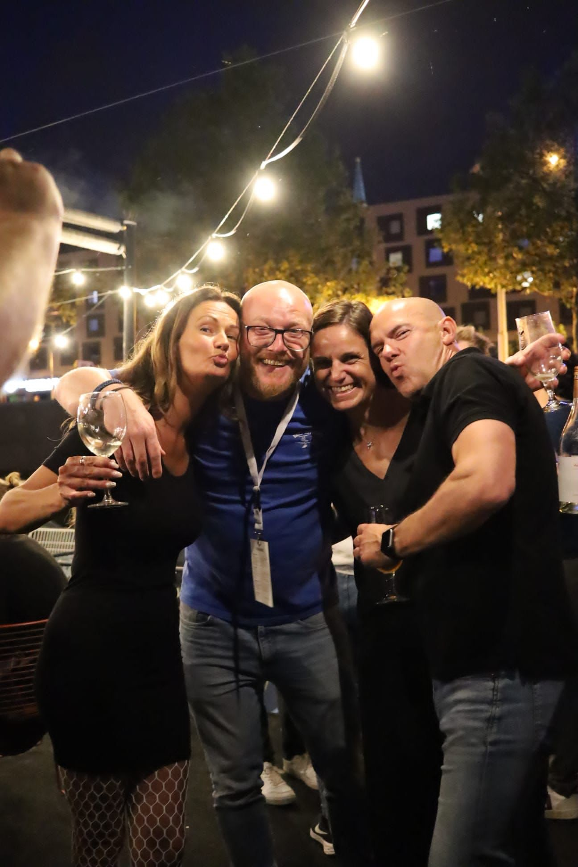
Situation = CEOs

Slide 2
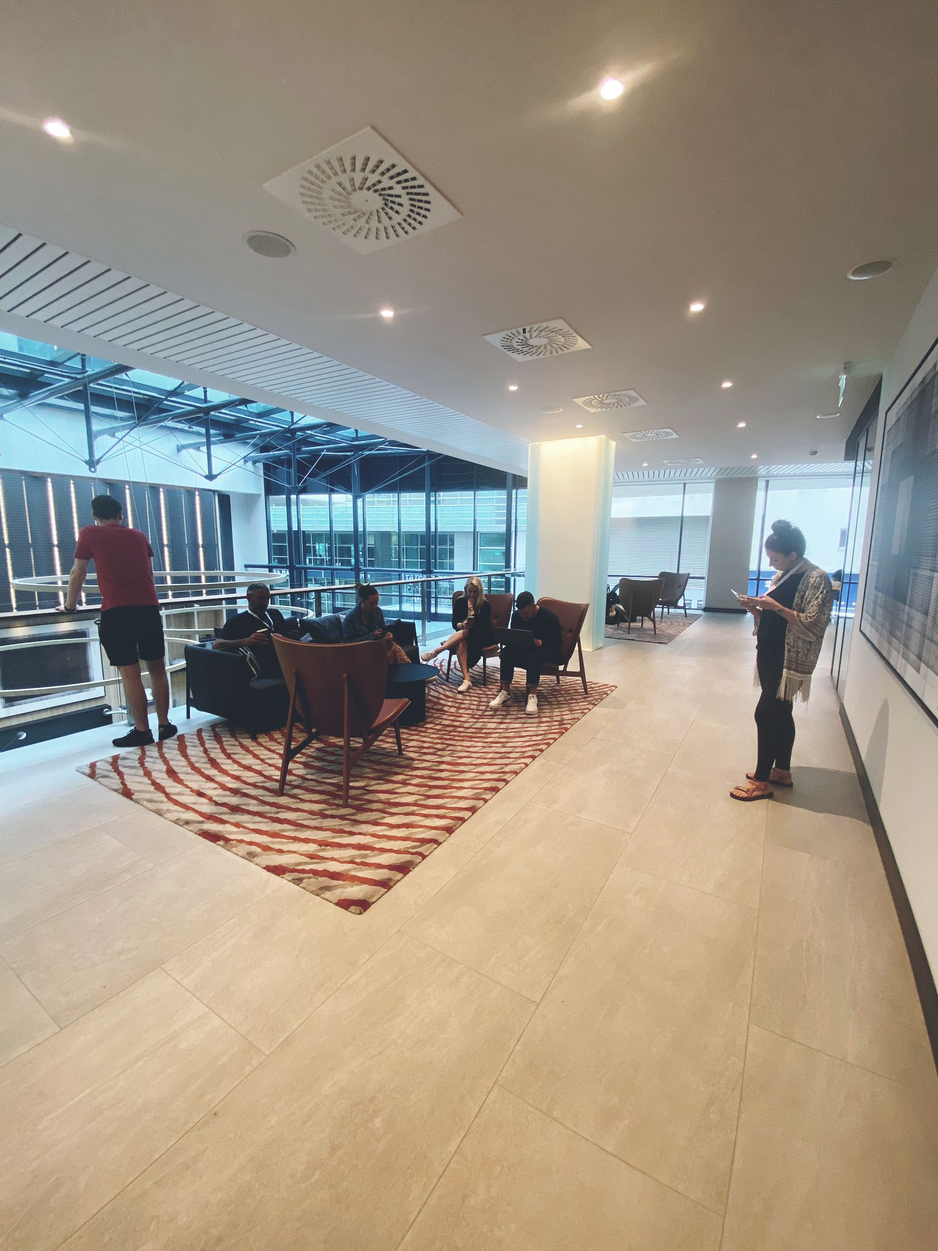
Situation = Us

Slide 3
Belonging
Value

Slide 4
How do we make belonging perceptible?
By connecting the Members.

Slide 5
Let’s talk about measures…

Slide 6
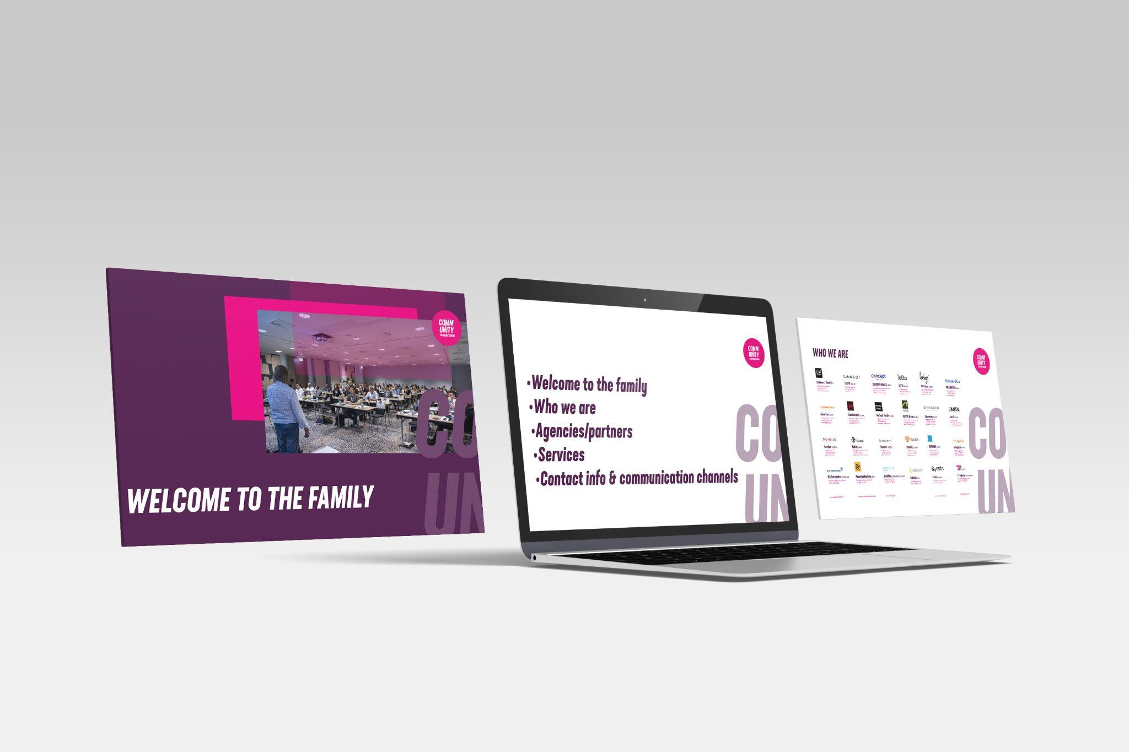
Onboarding: Welcome PPT
Why?
To educate (new) members about our network
To give (new) members all the resources at their disposal to be proactive in our network
What?
A PPT presenting the network, explaining how it works & what’s expected of its members
Who?
A steering group on a voluntary basis
When?
Production in July 2022
Usable from September 2022
Internal communication

Slide 7
Connecting members: Slack
Why?
To connect members beyond borders & strengthen the feeling of belonging
What?
Slack groups gathering our steering groups
Who?
All agencies (managers & members)
When?
Should be activated from october 2022
Internal communication

Slide 8
Social media bible
Why?
Making sure agencies publish coherently following the network rules & guidelines
What?
A book with concrete and simple guidelines and access info for all the channels
Who?
Coordinated by Jorg Borgwardt
When?
Produced in July 2022 and distributed to all the agencies in September 2022
Internal communication

Slide 9
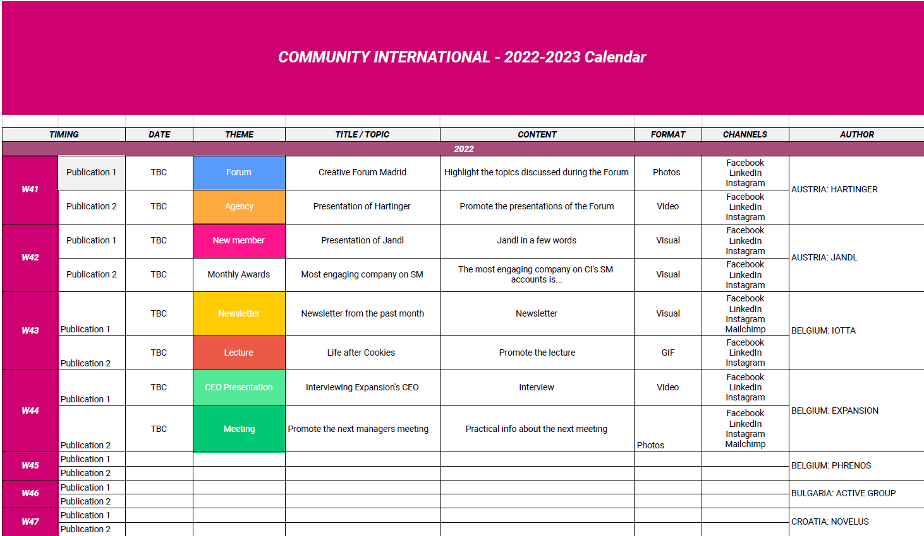
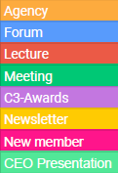
Editorial calendar
Why?
To involve all agencies in the SM management
What?
An editorial calendar presenting main themes & rotating management
Who?
All agencies as it’s already useable
When?
Active from October 2022
Internal communication

Slide 10
Giving news: Newsletter
Why?
keeping members informed & interested in the network
What?
3 articles to keep it short
Who?
3 agencies designing 1 collaborator to work in team (on Slack)
When?
Once a month as a retrospective
Internal communication

Slide 11
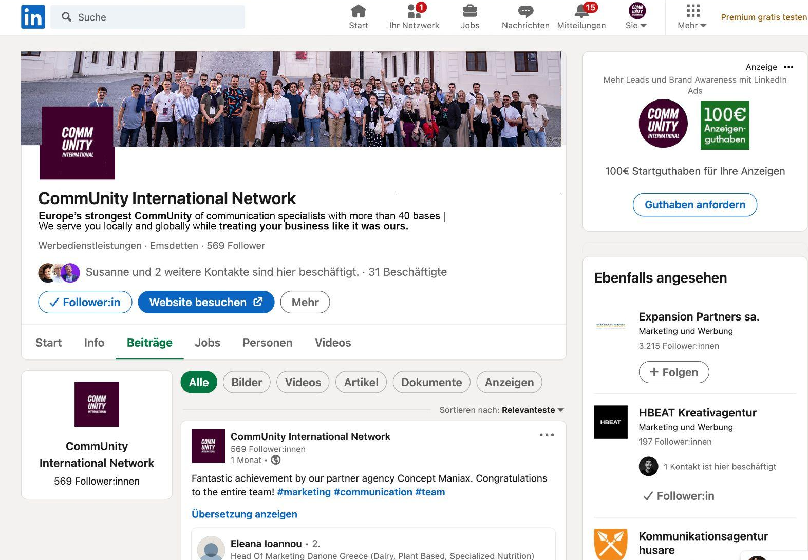
Execution: Social media profile optimisation
External communication

Slide 12
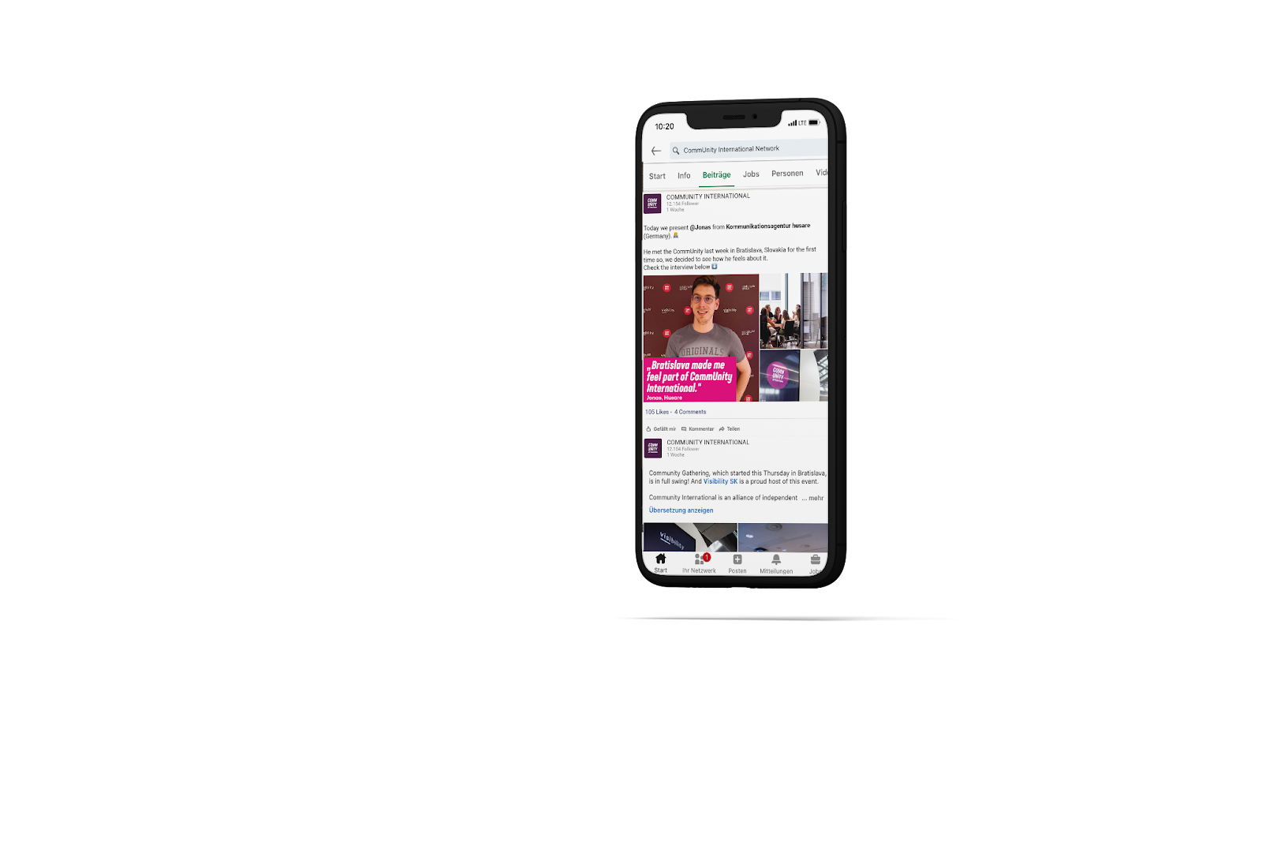
Execution: Faces behind…
CI communication mmmmm

Slide 13
Further Ideas
Friendly competition for trainees with incentives to collaborate
Build a feeling of belonging: this way everybody in the network is updated about the next move of a colleague from the network and spread the word about that. Feel proud!
create awards for companies: an award each month to a company that has proved excellent skills/activity in…
Responsibilise companies to create newsletters on a monthly basis
Ambassadors : as participants of the forums, we should be able to have time to tell the event to our agency’s members and to encourage them to participate in the next forums. We tell our story but it’s the manager’s responsibility to book the session.

Slide 14
Further ideas: Think outside of the box
Pitch-competition for trainees
Internal awards for members
CI communication mmmmm

Slide 15
Value
Belonging
CI communication mmmmm

Slide 16
Sharpen Positioning: From USP to VP
USP:
“We offer the most progressive, creative and diverse marketing talent in the world!”
Value Proposition:
“We help companies with potent marketing solutions that resonate with customers and deliver growth”.
External communication

Slide 17
HUGGING GROWTH

Slide 18
Hugging growth…
Hugging symbolises belonging (internal)
Everyone wants to grow (external):
as a person…
as an agency…
as a client…
across borders…
Hint to the concept of “growth-hacking”
CI communication mmmmm

Slide 20
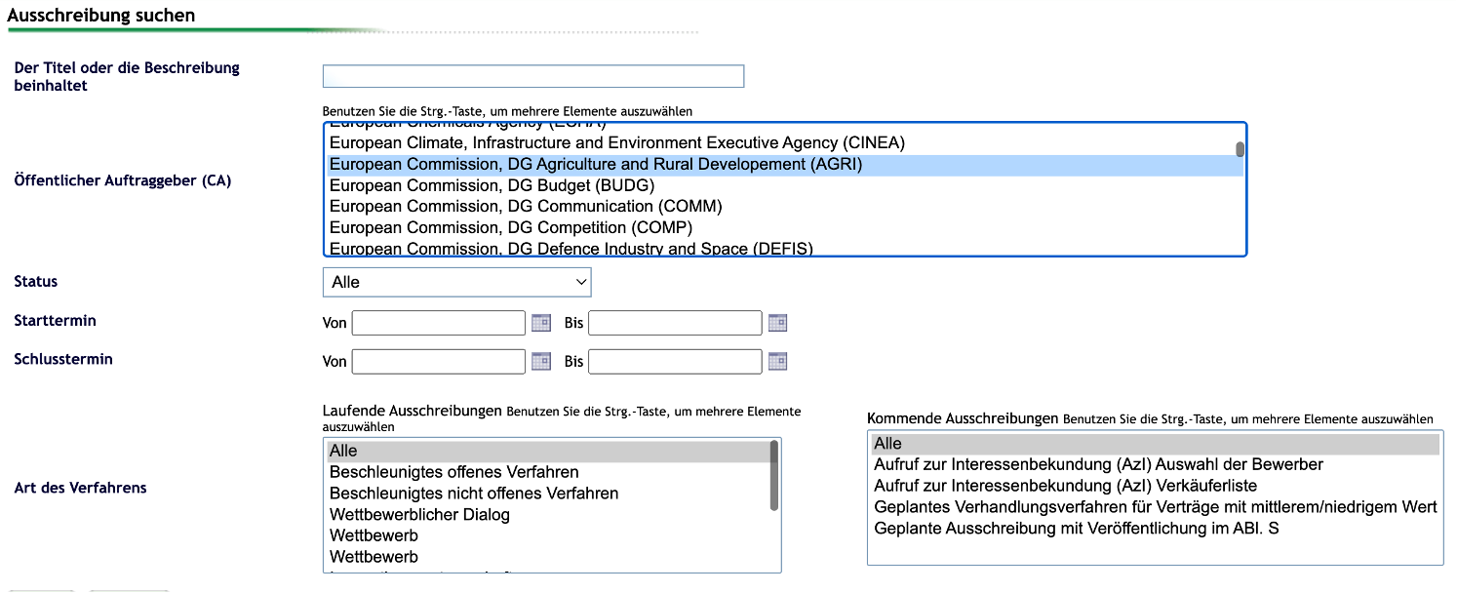
Potential Clients: New business (e.g. eTender)

Slide 21
Redefining the Website
Why?
Mirroring all our social media content & make it visible on the website in real time
Showing people’s emotions instead of plain text
What?
A social wall showing real time content without further creation & production expenses
Who?
The entire network by working on social channels
When?
Going live from October 2022

Slide 22
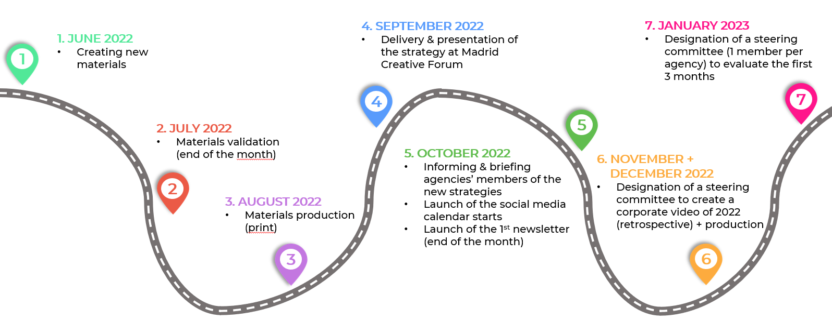
Put it in action : Timeline
CI communication mmmmm

Slide 23
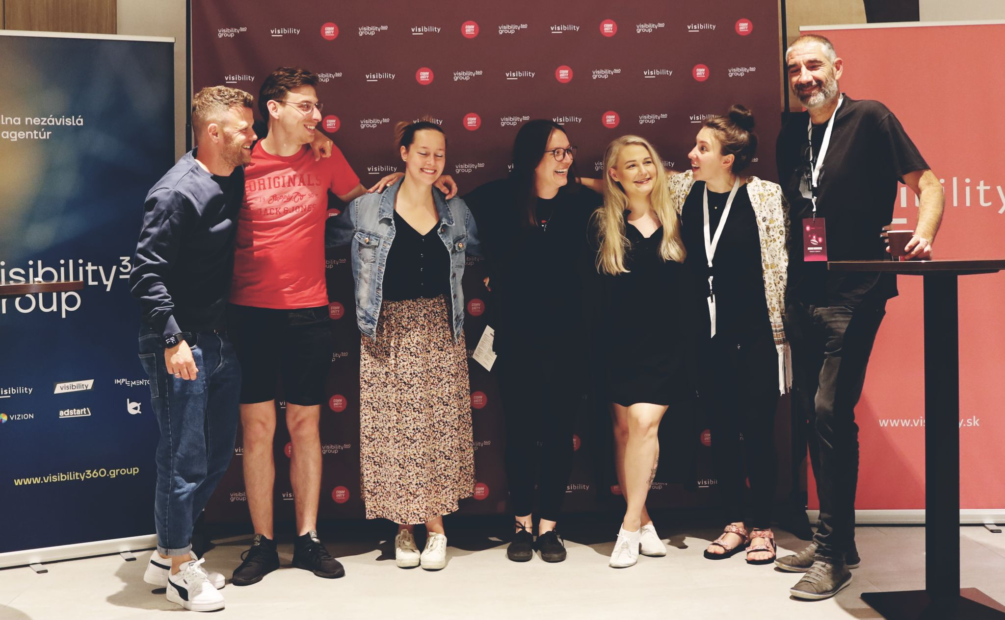
But first: Lets HUG
BUT FIRST: COMM TOGETHER & HUG

